Slide 1
Smart Cross Walking System
Capstone Project - GEE14007

Slide 2
Group Member
Eshita Bhowmik
Disha Hazra
UG/02/BTCSEAIML/2021/007
UG/02/BTCSEAIML/2021/014.
Dipanjan Laha
Priyanshu Bardhan
Mainak Ghosh
UG/02/BTCSEAIML/2021/015.
UG/02/BTCSE/2021/024
UG/02/BTCSEAIML/2021/005

Slide 3
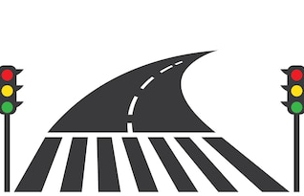
Introduction
This Project is Made to provide an aid to find nearest Traffic Signal or Zebra Crossing using Real time Map Facility.
It also shows the accurate location in terms of latitudes and Longitudes. Using this location, it shows nearest Zebra crossing or crossing signal and also the route to it.

Slide 4
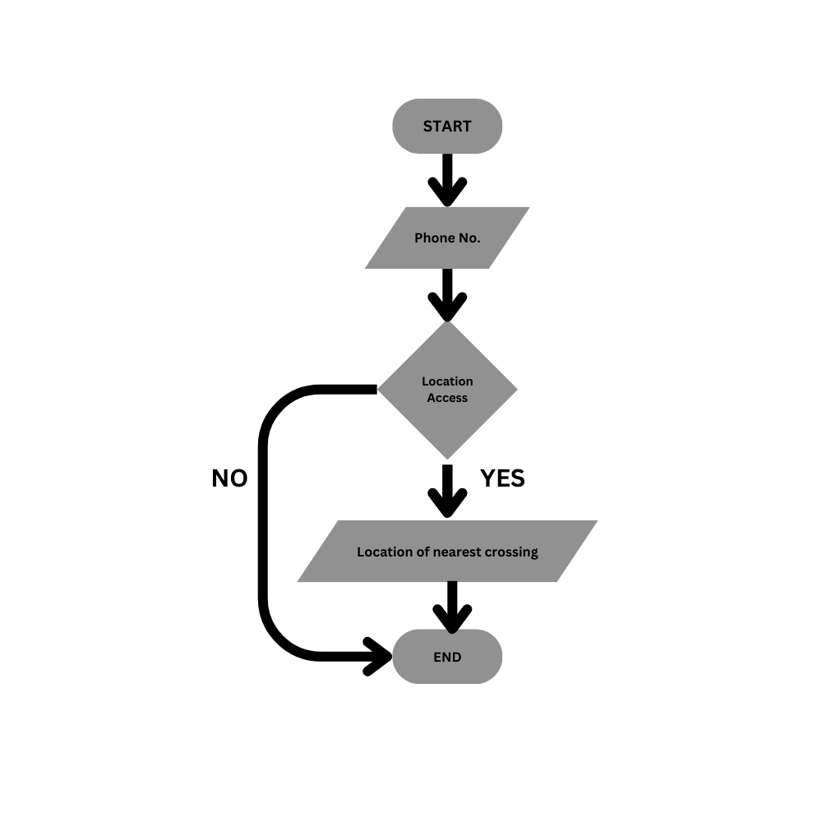
Architecture
This is simple website that is linked to google maps. It is build with the use of –
HTML
CSS
JavaScript
The flowchart is --

Slide 5
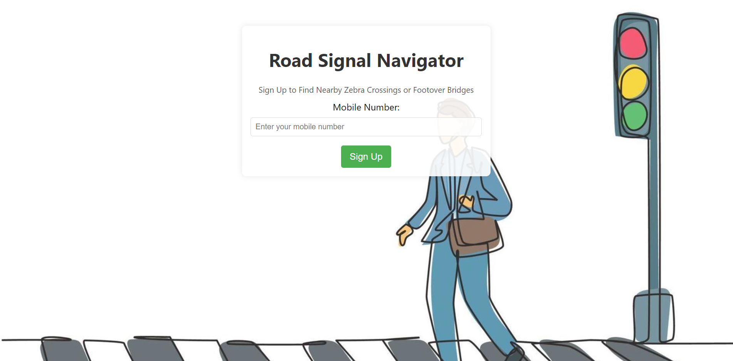
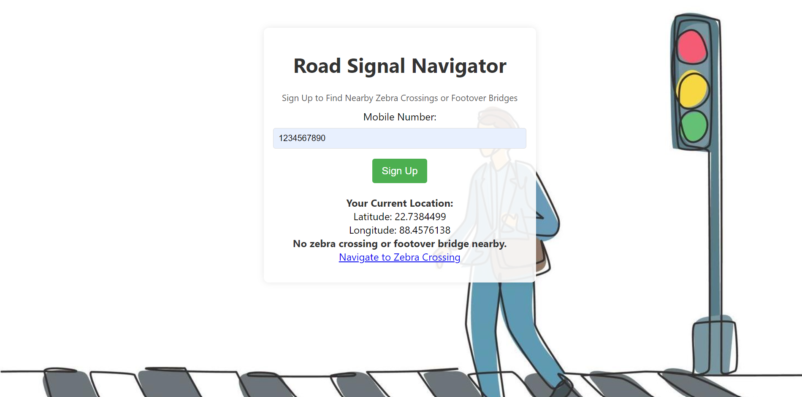
Output

Slide 6
Future Scope & Limitations
Future Scope
Limitations
More enhanced and secured Platform.
Make it ready for Mobile uses as an application.
More features like locating nearby subway, metro station, rail station, bus stop.
Allow Location sharing.
Notifications or alerts for nearby crossing to avoid accidents by over speeding.
Only Zebra Crossing is available.
Website for only PC uses.
No location sharing.

Slide 7
Conclusion
This is a proposed plan derived after brainstorming several other ideas around this topic. We would like to have feedbacks about this and would like to extend this project for further scopes.
This will be helpful to find nearest crossings or road signals so that accidents reduce.
Although there are other platforms to provide the same services , but we believe Accuracy and Alerts about nearest crossing or Signal is something that differs us.

Slide 8
THANK YOU !

